Slide 1
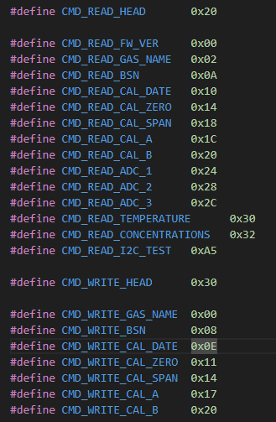
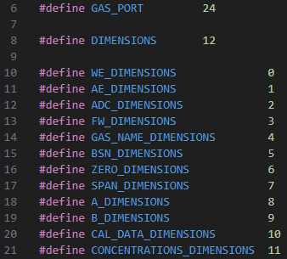
Sensor讀寫指令宣告:
Datalink位置宣告:
read
write

Slide 2
task_run()
measure_all_rht()
measure_gases_data()
measure_gases_info()
ui_parameter_post()
measure_all_rht()
measure_rht()
chk_ui_cmd()
measure_rht(UINT8 sht_count)
4顆感測器的溫溼度分別存在
sht_count = 0 : SHT3x_RHT[0] (溫度)
SHT3x_RHT[1] (濕度)
sht_count = 1 : SHT3x_RHT[2]
SHT3x_RHT[3]
Sht_count = 2 : SHT3x_RHT[4]
SHT3x_RHT[5]
sht_count = 3 : SHT3x_RHT[6]
SHT3x_RHT[7]
measure_gases_data()
gat_all_gas_data()
gat_all_gas_data(UINT8 port_numbers)
取得WE、AE、濃度(aeclmg_getAdc_2、aeclmg_getAdc_1、aeclmg_get_gas_concentrations)，並計算ADC，分別存在
WE datalink[port_numbers][WE_DIMENSIONS]
AE
datalink[port_numbers][AE_DIMENSIONS]
ADC
datalink[port_numbers][ADC_DIMENSIONS]
Concentrations
datalink[port_numbers][CONCENTRATIONS_DIMENSIONS]
measure_gases_info()
Gat_all_gas_info()
功能和gat_all_gas_data大致相同，跟sensor要求以以下資訊，存進datalink
gas_name
SerialId
Fw_version
Cal_date
Gas_cal_zero
Gas_cal_span
Gas_cal_a
Gas_cal_b
ui_parameter_post()
參考下一頁
chk_ui_cmd(UINT8 sht_count)
如果uart有收到東西(A0_RxBuf長度不為0)檢查是否有收到以下指令，並執行對應動作
command_Write_BSN()
寫入指定感測器bsn序號(未完成)
command_Wrire_Zero()
寫入零級(校正)(未完成)
command_Wrire_Span()
寫入span(校正)(未完成)
command_tabpage()
改變tabpage flag(data_to_UCA會用到)

Slide 3
ui_parameter_post()
data_to_UCA()
*ui command
data_to_UCA()
Int_to_str_func(datalink)
WE_to_UCA_count()
AE _to_UCA_count()
Zero_WE_ to_UCA_count()
Zero_AE _to_UCA_count()
Span _to_UCA_count()
FW_to_UCA_count()
BSN _to_UCA_count()
SSN _to_UCA_count()
Sensor_name _to_UCA_count()
ppb _to_UCA_count()
SHT _to_UCA_count()
ADC_produce()
Chk_ui_cmd()

